Slide 1
MACHINE LEARNING CLASSIFICATION
K NEAREST NEIGHBOUR (KNN)
SUPPORT VECTOR MACHINE
NAÏVE BAYES
DR. SHILOAH ELIZABETH D
Assistant Professor
Department of Computer Science and Engineering
Anna University

Slide 2
SUPERVISED LEARNING

Slide 3
Instance-Based Classifiers
Store the training records
Use training records to predict the class label of unseen cases
Examples:
Rote-learner - Memorizes entire training data and performs classification only if attributes of record match one of the training examples exactly
Nearest neighbor - Uses k “closest” points (nearest neighbors) for performing classification

Slide 4
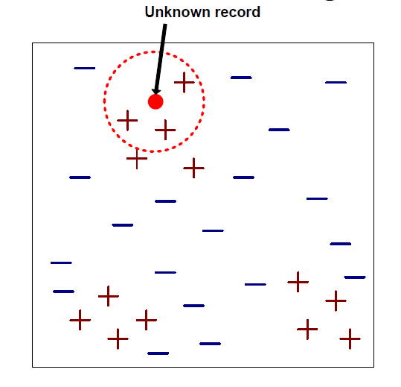
Nearest Neighbor Classifiers
Requires three things
The set of stored records
Distance Metric to compute distance between records
The value of k, the number of nearest neighbors to retrieve
To classify an unknown record:
Compute distance to other training records
Identify k nearest neighbors
Use class labels of nearest neighbors to determine the class label of unknown record (e.g., by taking majority vote)

Slide 5
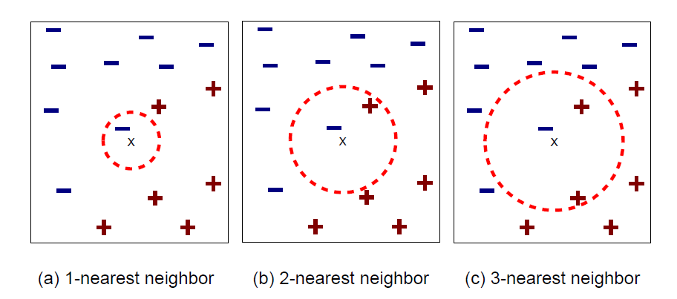
K-nearest neighbors of a record x are data points that have the k smallest distance to x

Slide 6
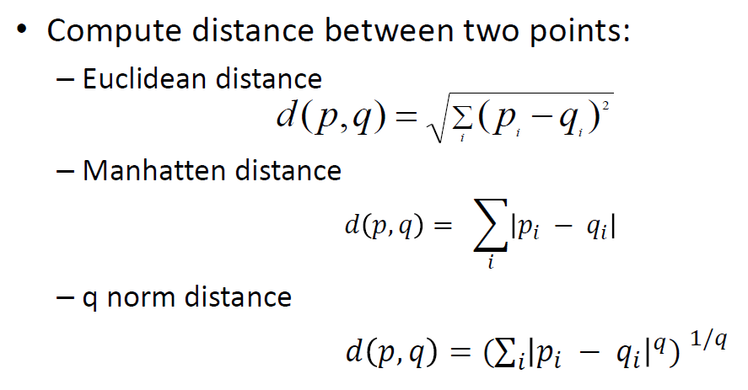
Nearest Neighbor
Compute distance between two points:

Slide 7
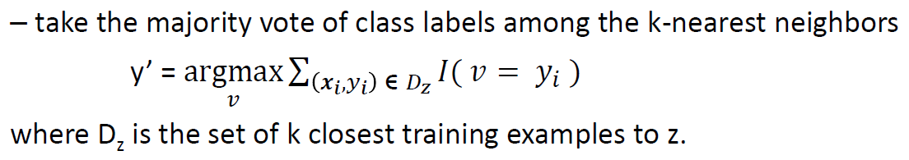
Nearest Neighbor Classification
Determine the class from nearest neighbor list

Slide 8
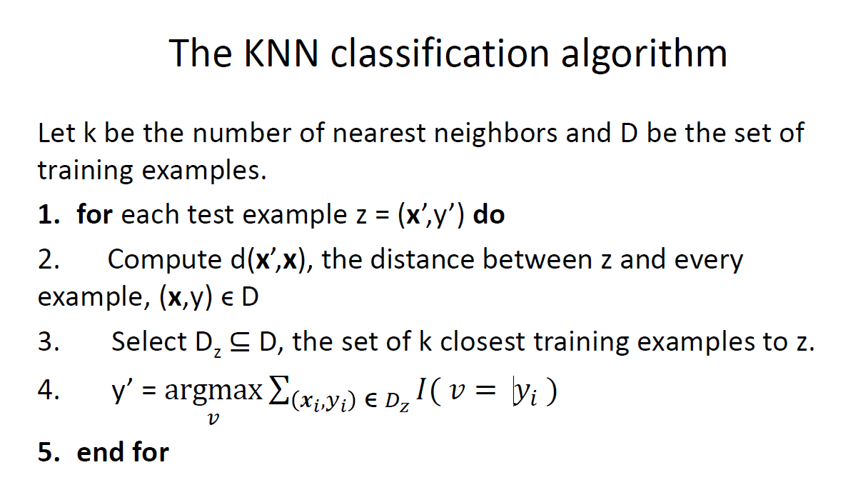

Slide 9
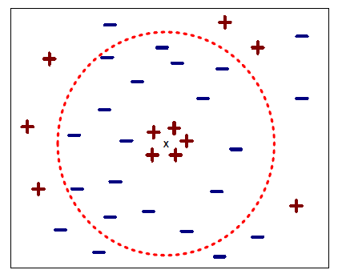
Nearest Neighbor Classification
Choosing the value of k:
If k is too small, sensitive to noise points
If k is too large, neighborhood may include points from other classes

Slide 10
Nearest Neighbor Classification
Normalization
Curse of Dimensionality
k-NN classifiers are lazy learners
It does not build models explicitly
Unlike eager learners such as decision tree induction and rule-based systems
Classifying unknown records are relatively expensive

Slide 11
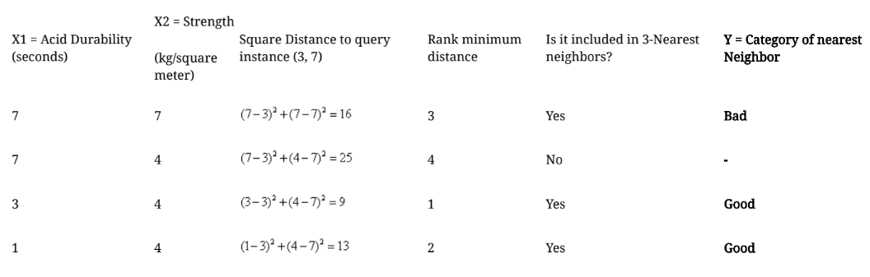
Example
We have data from the questionnaires survey (to ask people opinion) and objective testing with two attributes (acid durability and strength) to classify whether a special paper tissue is good or not. Here is four training samples:
X1 = Acid Durability (seconds) and X2 = Strength(kg/square meter); Y = Classification
(7, 7, Bad); (7, 4, Bad); (3, 4, Good); (1, 4, Good)
Now the factory produces a new paper tissue that pass laboratory test with X1 = 3 and X2 = 7. Without another expensive survey, can we guess what the classification of this new tissue is?
We have 2 good and 1 bad, since 2>1 then we conclude that a new paper tissue that pass laboratory test with X1 = 3 and X2 = 7 is included in Good category.

Slide 12
SUPPORT VECTOR MACHINE (SVM)

Slide 13
SUPPORT VECTOR MACHINE (SVM)
SVM is a kernel method
Give better classification performance than other ML algorithms on reasonably sized datasets.
They do not work well on extremely large datasets since they involve a data matrix inversion which is very expensive.

Slide 14
SVM – When data is linearly separable

Slide 15
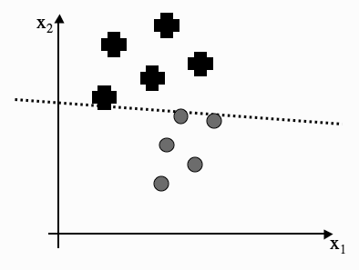
OPTIMAL SEPARATION
Three different classification lines. Is there any reason why one is better than the others?

Slide 16
OPTIMAL SEPARATION
All three of the lines that are drawn separate out the two classes,
so in some sense they are ‘correct’, and
the Perceptron would stop its training if it reached any one of them.
we prefer a line that runs through the middle of the separation between the datapoints from the two classes,
staying approximately equidistant from the data in both classes.
If we pick the lines shown in the left or right graphs,
then there is a chance that a datapoint from one class will be on the wrong side of the line,
just because we have put the line tight up against some of the datapoints we have seen in the training set.

Slide 17
The Margin and Support Vectors
The margin is the largest region we can put that separates the classes without there being any points inside, where the box is made from two lines that are parallel to the decision boundary.
The classifier in the middle of the Figure has the largest margin of the three. It has the imaginative name of the maximum margin (linear) classifier.
The datapoints in each class that lie closest to the classification line are called support vectors.

Slide 18
SVM
Using the argument that the best classifier is the one that goes through the middle of no-man’s land, we can now make two arguments:
the margin should be as large as possible, and
the support vectors are the most useful datapoints because they are the ones that we might get wrong.
This leads to an interesting feature of these algorithms:
after training we can throw away all of the data except for the support vectors, and use them for classification

Slide 19
SVM
Computing optimal decision boundary from a given set of datapoints
w - weight vector (a vector, not a matrix, since there is only one output)
x - input vector
Output y = w· x+b, with b being the contribution from the bias weight
We use the classifier line by saying that
any x value that gives a positive value for w · x + b is above the line, and so is an example of the ‘+’ class,
any x that gives a negative value is in the ‘o’ class.

Slide 20
SVM
Let us include our no-man’s land
If the absolute value is less than our margin M, which would put it inside the grey box
w · x is the inner or scalar product, w · x.
This can also be written as w^{T} x, which means that we can treat the vectors as degenerate matrices and use the normal matrix multiplication rules.
For a given margin value M we can say that any point x
where w^{T} x + b ≥ M is a plus, and
any point where w^{T} x + b ≤ −M is a circle.
The actual separating hyperplane is specified by w^{T} x + b = 0.

Slide 21
SVM
support vector - a point x⁺ that lies on the ‘+’ class boundary line, so that w^{T} x⁺ = M
If we want to find the closest point that lies on the boundary line for the ‘o’ class, then we travel perpendicular to the ‘+’ boundary line until we hit the ‘o’ boundary line.
The point that we hit is the closest point, and we’ll call it x⁻
the distance travelled to get to the separating hyperplane is M
from x+ to x- is 2M
to write down the margin size M in terms of w
w is perpendicular to the classifier line, the ‘+’ and ‘o’ boundary lines
so the direction travelled from x+ to x- is along w.
to make w a unit vector w/||w||, and so we see that the margin is 1/||w||

Slide 22
Bayesian Classification: Why?
A statistical classifier: performs probabilistic prediction, i.e., predicts class membership probabilities
Foundation: Based on Bayes’ Theorem.
Performance: A simple Bayesian classifier, naïve Bayesian classifier, has comparable performance with decision tree and selected neural network classifiers
Incremental: Each training example can incrementally increase/decrease the probability that a hypothesis is correct — prior knowledge can be combined with observed data
Standard: Even when Bayesian methods are computationally intractable, they can provide a standard of optimal decision making against which other methods can be measured

Slide 23
Bayes’ Theorem: Basics
Total probability Theorem:
Bayes’ Theorem:
Let X be a data sample (“evidence”): class label is unknown
Let H be a hypothesis that X belongs to class C
Classification is to determine P(H|X), (i.e., posteriori probability): the probability that the hypothesis holds given the observed data sample X
P(H) (prior probability): the initial probability
E.g., X will buy computer, regardless of age, income, …
P(X): probability that sample data is observed
P(X|H) (likelihood): the probability of observing the sample X, given that the hypothesis holds
E.g., Given that X will buy computer, the prob. that X is 31..40, medium income

Slide 24
Prediction Based on Bayes’ Theorem
Given training data X, posteriori probability of a hypothesis H, P(H|X), follows the Bayes’ theorem
Informally, this can be viewed as
posteriori = likelihood x prior/evidence
Predicts X belongs to C_{i} iff the probability P(C_{i}|X) is the highest among all the P(C_{k}|X) for all the k classes
Practical difficulty: It requires initial knowledge of many probabilities, involving significant computational cost

Slide 25
Classification Is to Derive the Maximum Posteriori
Let D be a training set of tuples and their associated class labels, and each tuple is represented by an n-D attribute vector X = (x₁, x₂, …, x_{n})
Suppose there are m classes C₁, C₂, …, C_{m}.
Classification is to derive the maximum posteriori, i.e., the maximal P(C_{i}|X)
This can be derived from Bayes’ theorem
Since P(X) is constant for all classes, only
needs to be maximized

Slide 26
Naïve Bayes Classifier
A simplified assumption: attributes are conditionally independent (i.e., no dependence relation between attributes):
This greatly reduces the computation cost: Only counts the class distribution
If A_{k} is categorical, P(x_{k}|C_{i}) is the # of tuples in C_{i} having value x_{k} for A_{k} divided by |C_{i, D}| (# of tuples of C_{i} in D)
If A_{k} is continous-valued, P(x_{k}|C_{i}) is usually computed based on Gaussian distribution with a mean μ and standard deviation σ
and P(x_{k}|C_{i}) is

Slide 27
Naïve Bayes Classifier: Training Dataset
Class:
C1:buys_computer = ‘yes’
C2:buys_computer = ‘no’
Data to be classified:
X = (age <=30,
Income = medium,
Student = yes
Credit_rating = Fair)

Slide 28
Naïve Bayes Classifier: An Example
P(C_{i}): P(buys_computer = “yes”) = 9/14 = 0.643
P(buys_computer = “no”) = 5/14= 0.357
Compute P(X|C_{i}) for each class
P(age = “<=30” | buys_computer = “yes”) = 2/9 = 0.222
P(age = “<= 30” | buys_computer = “no”) = 3/5 = 0.6
P(income = “medium” | buys_computer = “yes”) = 4/9 = 0.444
P(income = “medium” | buys_computer = “no”) = 2/5 = 0.4
P(student = “yes” | buys_computer = “yes) = 6/9 = 0.667
P(student = “yes” | buys_computer = “no”) = 1/5 = 0.2
P(credit_rating = “fair” | buys_computer = “yes”) = 6/9 = 0.667
P(credit_rating = “fair” | buys_computer = “no”) = 2/5 = 0.4
X = (age <= 30 , income = medium, student = yes, credit_rating = fair)
P(X|C_{i}) : P(X|buys_computer = “yes”) = 0.222 x 0.444 x 0.667 x 0.667 = 0.044
P(X|buys_computer = “no”) = 0.6 x 0.4 x 0.2 x 0.4 = 0.019
P(X|C_{i})*P(C_{i}) : P(X|buys_computer = “yes”) * P(buys_computer = “yes”) = 0.028
P(X|buys_computer = “no”) * P(buys_computer = “no”) = 0.007
Therefore, X belongs to class (“buys_computer = yes”)

Slide 29
Avoiding the Zero-Probability Problem
Naïve Bayesian prediction requires each conditional prob. be non-zero. Otherwise, the predicted prob. will be zero
Ex. Suppose a dataset with 1000 tuples, income=low (0), income= medium (990), and income = high (10)
Use Laplacian correction (or Laplacian estimator)
Adding 1 to each case
Prob(income = low) = 1/1003
Prob(income = medium) = 991/1003
Prob(income = high) = 11/1003
The “corrected” prob. estimates are close to their “uncorrected” counterparts

Slide 30
Naïve Bayes Classifier: Comments
Advantages
Easy to implement
Good results obtained in most of the cases
Disadvantages
Assumption: class conditional independence, therefore loss of accuracy
Practically, dependencies exist among variables
E.g., hospitals: patients: Profile: age, family history, etc.
Symptoms: fever, cough etc., Disease: lung cancer, diabetes, etc.
Dependencies among these cannot be modeled by Naïve Bayes Classifier
How to deal with these dependencies? Bayesian Belief Networks

